Slide 1
Introduction to Programming in C++

Slide 2
Compilers versus Interpreters
A compiler produces a stand-alone binary for a given platform (cpu+operating system). The output of a compiler is an object file, represented with a .o suffix on Unix.
A linker takes the .o files and any external libraries and links them into the executable. Normally the linker is invoked through the compiler.
An interpreter interprets line by line. The binary that is run is the interpreter itself. Programs for interpreters are often called scripts. Scripts are frequently cross platform, but the interpreter itself must be appropriate to the platform.

Slide 3
Compiled Languages
Compiled languages are:
Generally stricter about typing (static typing) and memory allocation.
Generally produce faster and more efficient runs.
Interpreted languages are:
Generally looser about typing (dynamic typing).
Generally have dynamically sized data structures built in.
Often run very slowly.

Slide 4
Strengths and Weaknesses
C++ (not C)
Fortran
Limited mathematical built-ins
True multidimensional arrays not possible without add-on libraries (Blitz++, Boost)
Pretty good string handling (compared to C)
Straightforward implementation of classes (but no modules)
(2003/8) Many math function built-ins
Multidimensional arrays a first-class data structure, array operations supported
Does not support true strings yet, just character arrays
Classes somewhat clunky. Modules fill much of this role.

Slide 5
Setting Up Your Environment

Slide 6
Integrated Development Environments
An Integrated Development Environment (IDE) combines an editor and a way to compile and run programs in the environment.
A well-known IDE for Microsoft Windows is VisualStudio. Available through Microsoft Store, not free for individuals.
Mac OSX uses Xcode as its native IDE. Xcode includes some compilers, particularly for Swift, but it can manage several other languages. Available at App Store, free.
A full-featured cross-platform IDE is Eclipse (www.eclipse.org). Free.
A lighter-weight IDE for Windows and Linux is Code::Blocks (www.codeblocks.org). Free.
We will use a very lightweight IDE called Geany since it is free, easy to install and use, and works on all three platforms.

Slide 7
Linux
For users of the University of Virginia's cluster, first load a compiler module.
module load gcc
brings a newer gcc, g++, and gfortran into the current environment
module load geany
geany &
Geany is also available for all popular Linux distributions and can be installed through the distribution's package manager.

Slide 8
Windows and Mac
Geany can be installed on Windows and Mac through the usual software installation methods.
Geany does not install a compiler suite. This must be performed independently.
Macs with Xcode include gcc and g++ but not gfortran.
Windows does not include a default compiler suite, but VisualStudio includes Microsoft C and C++.
Geany can be downloaded for Mac or Windows starting from its home page
www.geany.org

Slide 9
Installing Compilers on Macs
Install Xcode from the App Store.
If you are going to use Fortran, download a binary for your version of OSX from
https://gcc.gnu.org/wiki/GFortranBinaries

Slide 10
Installing Compilers on Windows
MinGW provides a free distribution of gcc/g++/gfortran
Executables produced by the standard MinGW package will be 32 bits
Also install MSYS for a minimalist Unix system.
Download from www.mingw.org
Run installer
Choose packages to install, then click Apply.
After the installation, follow instructions for "After Installing" at http://www.mingw.org/wiki/Getting_Started
Be sure to modify your path environment variable

Slide 11
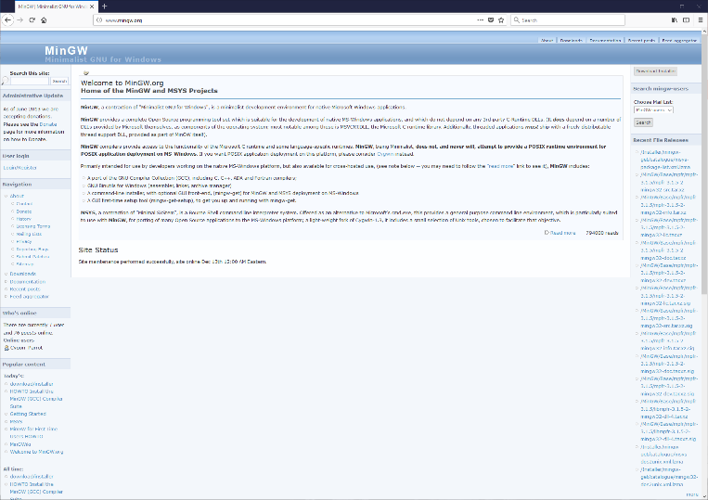
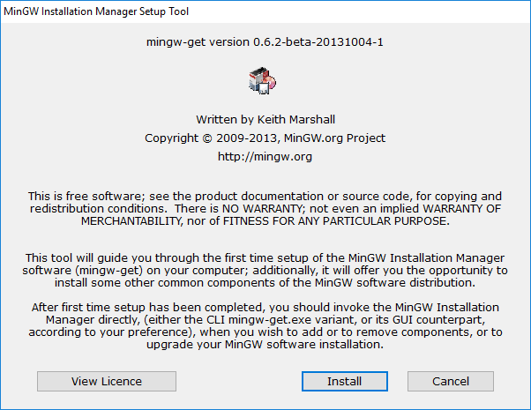
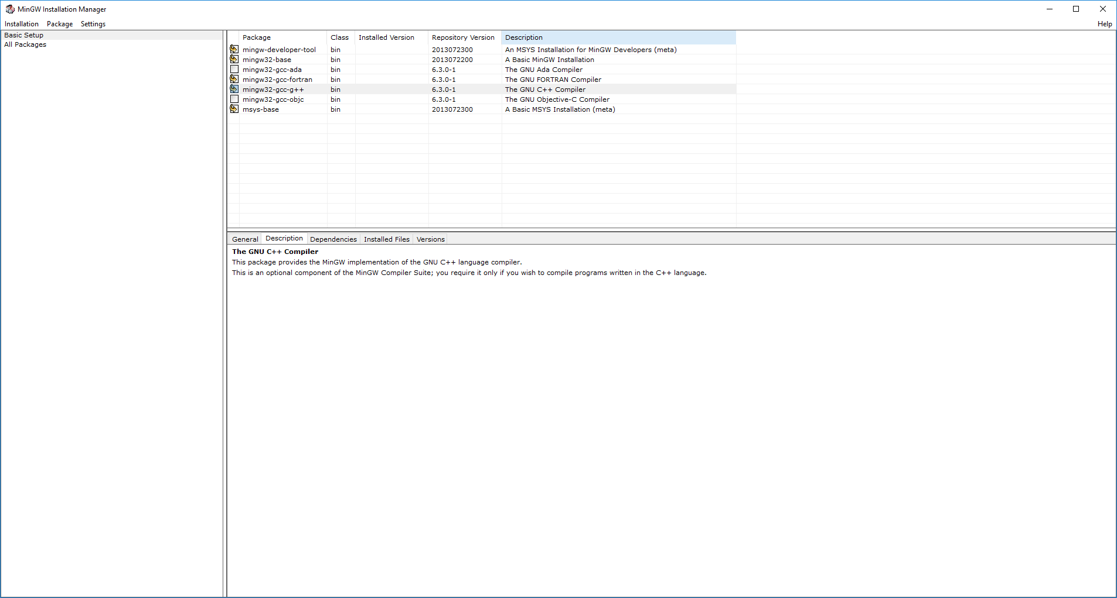
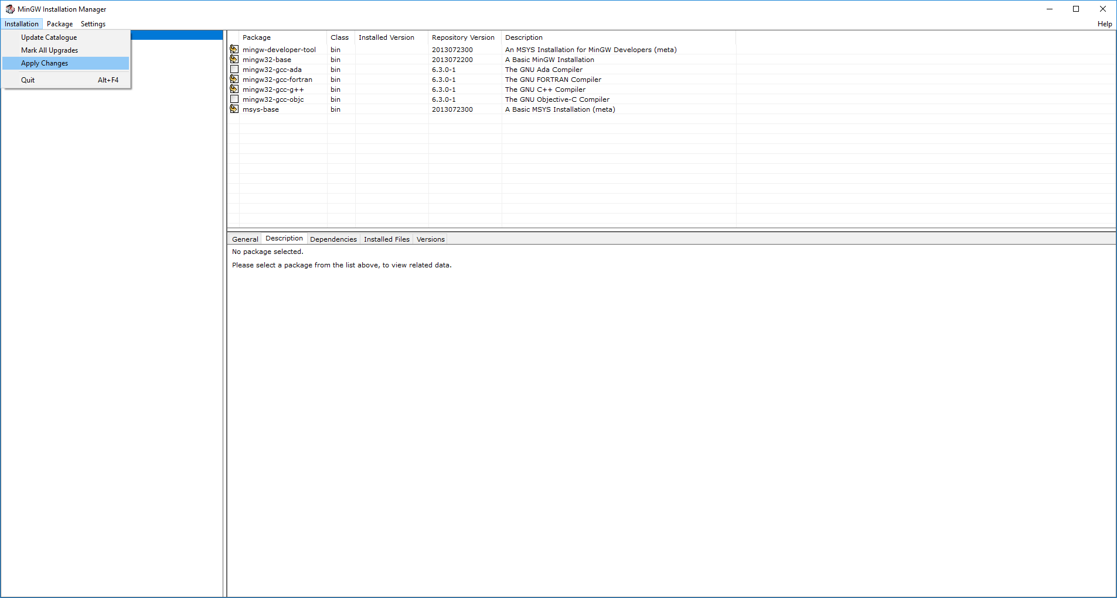
MinGW

Slide 12
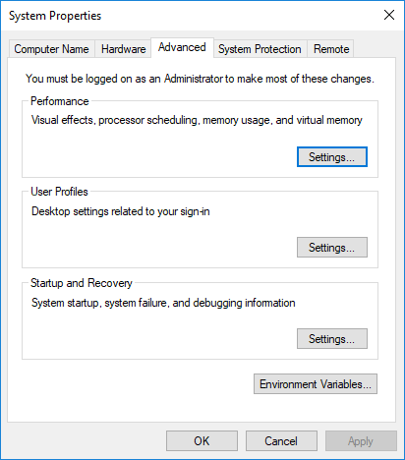
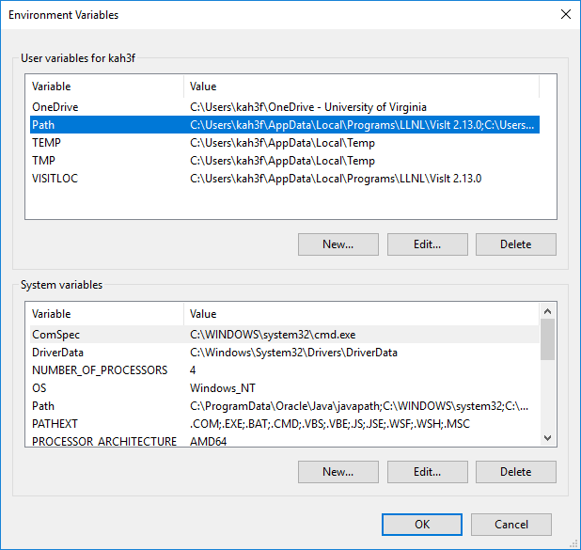
Environment Variables in Windows
Control Panel->System and Security->Advanced system settings->Environment Variables
Once you open Path, click New to add to the Path

Slide 13
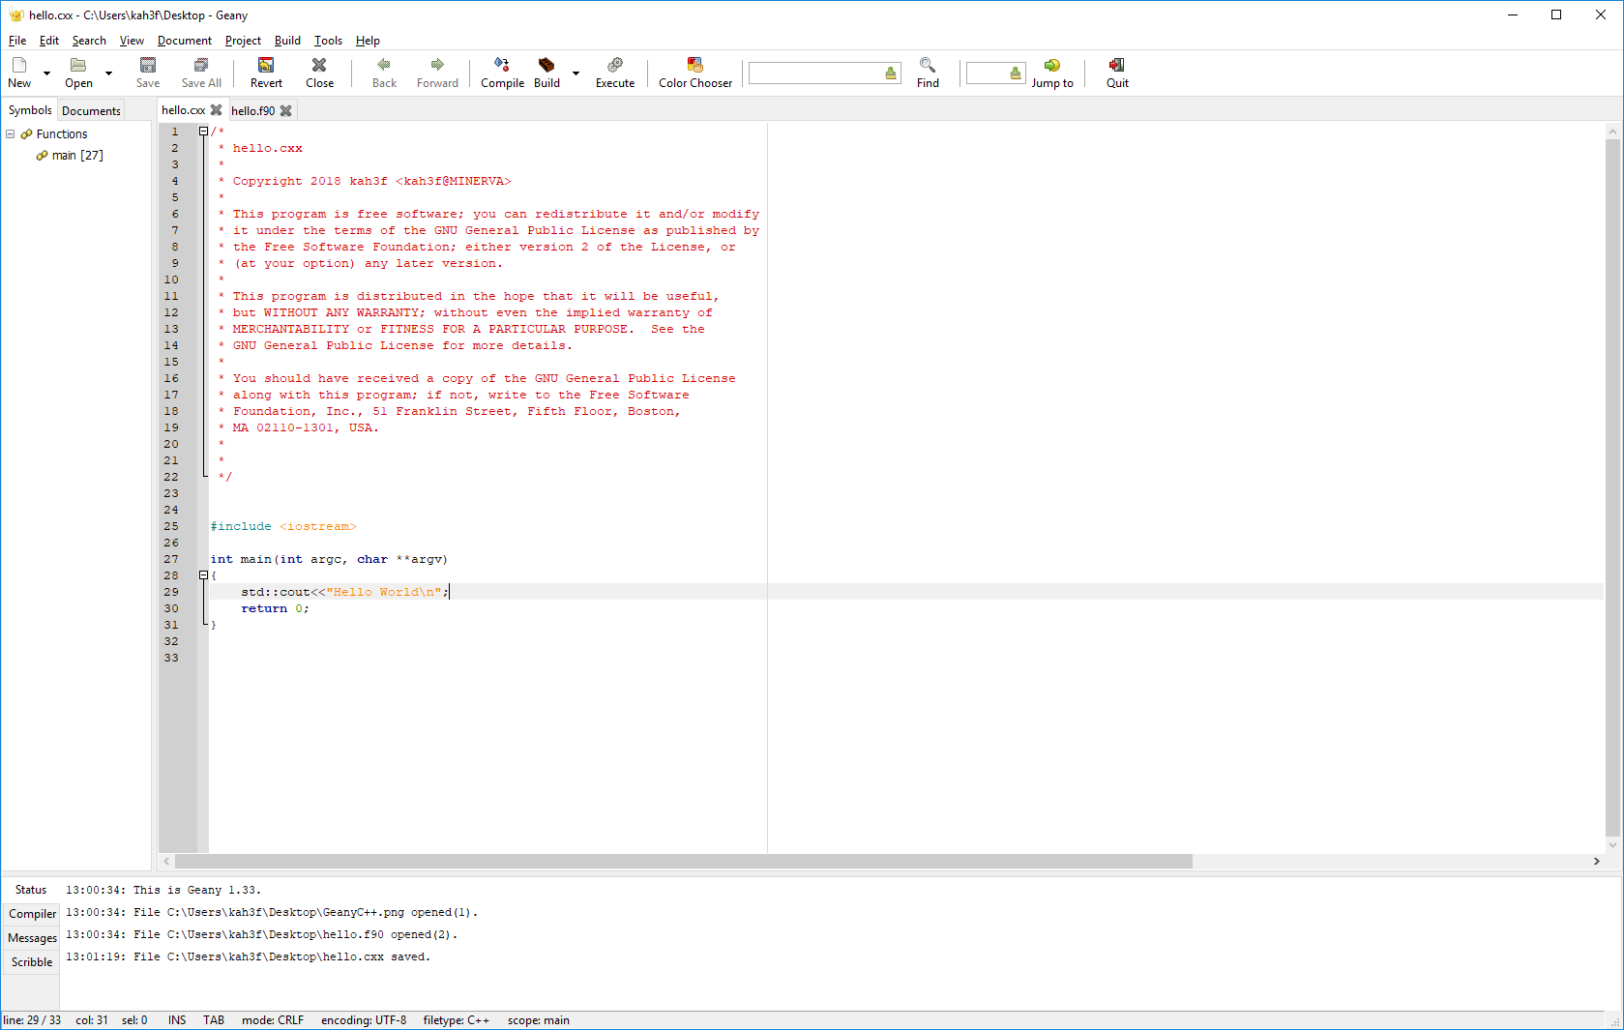
Geany on Windows

Slide 14
Variables

Slide 15
Variables in C++
Like most programming languages, C++ is case sensitive. Variables Mean and mean are different to the compiler.
Like most compiled languages, C++ is statically typed. All variables must be declared to be of a specific type before they can be used. A variable’s type cannot be changed once it is declared.
C++ is (nearly) strongly typed. Mixed-mode expressions are limited and most conversions must be explicit.

Slide 16
Numeric Types: Integer
Integer (int)
Quantities with no fractional part
Represented by sign bit + value in binary
Remember that computers do not use base 10 internally
Default integers are of size 32 bits
Maximum signed integer is is 2³²-1
unsigned int is a type that covers only nonnegative ints
Other types
long may be either 32 or 64 bits depending on compiler/platform
Standard requires only that it be at least 32 bits.
Usually 32 bits on Windows, 64 bits on other platforms now.
short is 16 bits
long long is a 64-bit integer (C++11 standard, before that an extension)

Slide 17
Numeric Types: Single Precision
Floating point single precision float
Sign, exponent, mantissa
32 bits
IEEE 754 defines representation and operations
Approximately 7-8 decimal digits of precision, approximate exponent range is 10⁻¹²⁶ to 10¹²⁷

Slide 18
Numeric Types: Double Precision
Double precision floating point double
Sign, exponent, mantissa
64 bits
Number of bits NOT a function of the OS type! It is specified by the IEEE 754 standard!
Approximately 15-17 decimal digits of precision, approximate exponential range 10⁻³⁰⁸ to 10³⁰⁸

Slide 19
Non-numeric Types: Boolean
Booleans are represent truth value bool
Values can be true or false
Internally true is 1 and false is 0, but it’s easier for humans to read and remember true/false.

Slide 20
Non-numeric Types: Character
Character char
1 byte (8 bits) per single character
A character has a fixed length that must be declared at compile time, unless it is treated as allocatable (more on that later).
char[8] mychar;
The default length is 1, however.
char letter;

Slide 21
Non-numeric Types: String
A string is a sequence of characters of variable length.
Requires adding a header
#define <string.h>
The string is a class, which is a little beyond our scope right now. But you can still use basic functions without understanding the class.
string str, str1, str2;
str.size(); // length of string
str1+str2; // concatenate two strings
str.substr(2,5); // substring (counts from 0)

Slide 22
Literals
Literals aka constants
Specified values e.g.
3
3.2
3.213e0
"This is a string"
"Isn’t it true?"
true
Literals have a type but it is determined from the format rather than a declaration.

Slide 23
Variable Declarations
Variables are declared by indicating the type followed by a comma-separated list of variables followed by a semicolon.
int i,j,k;
float x, y;

Slide 24
Initializing at Compile Time
Variables can be declared and initialized at the same time:
float x=1.e-8, y=42.;
int i,j,k,counter=0;

Slide 25
Pointers and References
A pointer is a variable that points to a location in memory.
C++ has ways to avoid pointers, but they still appear regularly in much code.
Pointers are declared with *
float *x, y;
x is a pointer, y is a variable.
The value of a pointer is obtained explicitly by the dereference operator &
y=99.;
x=&y; //x now points to location of y
cout<<x<<" "<<*x<<" "<<y<<"\n";
0x7ffe577a0494 99 99

Slide 26
Example
Start Geany (or whatever editor you want to use). Type
#include <iostream>
int main() {
/* My first program
Author: Your Name
*/
float x,y;
int i,j=11;
x=1.0;
y=2.0;
i=j+2;
std::cout<<"Reals are "<<x<<" "<<y<<"\n";
std::cout<<"Integers are "<<i<<" "<<j<<"\n";
return 0;
}

Slide 27
const
In compiled languages, programmers can declare a variable to have a fixed value that cannot be changed.
In C/C++ this is indicated by the const attribute.
const float pi=3.14159;
Attempting to change the value of a variable declared to be a parameter will result in a fatal compiler error.

Slide 28
Type Conversions
Most compilers will automatically cast numeric variables to make mixed expressions consistent. The variables are promoted according to their rank. Lowest to highest the types are integer, float, double, complex.
Use explicit casting to be clear, or in circumstances such as argument lists where the compiler will not do it.
Strings may be cast to numbers and vice versa by a stringstream (this is the "correct" C++ way).

Slide 29
Examples
Explicit casting among numeric types, default kind.
R=(float) I;
I=(int) R;
D=(double)R;

Slide 30
Character ⬄ Numeric
Stringstreams are internal string buffers.
Convert numeric to character:
#include <iostream>
#include <string>
#include <sstream>
using namespace std;
int main() {
string age;
int iage;
iage=39
stringstream ss;
ss<<iage; //load iage into buffer
age=ss.str();
Convert character to numeric
age='51'
stringstream ss2(age);
ss2>>iage;
}

Slide 31
Arithmetic Operations
Operators are defined on integers, floats, and doubles
+ - add subtract
* / multiply divide
Operator Precedence is:
(* /) (+ -)
Evaluation is left to right by precedence unless told otherwise with parentheses

Slide 32
Integer Operators
In C++ 2/3 is always zero! Why?
Because 2 and 3 are both integers. Nothing will be promoted to a float, so / is an integer operation that yields an integer result
Remainder can be obtained from %
Use for negatives is uncommon in all languages and may not behave as you expect.

Slide 33
Boolean Operators
Negation
!
!flag
AND
&&
OR
||

Slide 34
Conditional Operators
Numeric
equals ==
not equal /=
strictly less than <
strictly greater than >
less than or equal to <=
greater than or equal to >=

Slide 35
Conditional Operator Precedence
>,>=,<,<= outrank == or !=
==,!= outranks &&
&& outranks ||
As always, use parentheses to change grouping or to improve clarity.

Slide 36
Exercise
Exercises with conditionals.
Be sure to declare variables appropriately.
a=11.; b=9.; c=45; n=3;
cout<< boolalpha << (a>b)<<"\n";
cout << (a<b && c==n) << "\n";
cout << (a<b || c==n) << "\n";
cout << (a>b || c==n && a<b) <<"\n";
cout <<(a>b || c==n) && a<b << "\n"'
bool is_equal= a==b;
cout<<is_equal<<"\n";

Slide 37
Expressions and Statements

Slide 38
Expressions in C++
C++ expressions are much like those of other languages.
a+3*c
8.0*(double)i+pow(v,3)
sqrt(abs(a-b))
A || B
y > 0.0 && y < 1.0
myfunc(x,y)

Slide 39
Statements
Indentation is not required but should be used!
Statements are terminated with a semicolon.
Code Blocks
Code blocks are multiple statements that are logically a single statement.
C++ uses curly braces {} to enclose blocks.
Two styles. Pick one and be consistent:
if (cond) { if (cond)
statements; {
} statements
}

Slide 40
Hello World
#include <iostream>
using namespace std;
int main (int argc, char ** argv) {
cout<<"Hello world\n";
return 0;
}

Slide 41
Exercise
Write a program that will declare and set variables as indicated and will print the expressions indicated. You may use your "hello world" program as a base.
x=17.
Xs=11.
num_1=10
num_2=14
cout<<x<<"\n";
cout<<Xs/x<<"\n";
cout<<(int)Xs/x<<"\n";
cout<<int(Xs)/int(x)<<"\n";
cout<<Xs/x + x<<"\n";
cout<<Xs/(x+x)<<"\n";
cout<<x/num_1<<"\n";
cout<<num_1/num_2<<"\n";
cout<<num_2/num_1<<"\n";

Slide 42
Exercise
Declare string variables large enough to hold the indicated strings. Include the header
#include <string>
string title="This is a string";
string subtitle="Another string"
cout<<title.size()<<"\n";
string newtitle=title+":"+subtitle;
cout<<newtitle<<"\n";
cout<<newtitle.substr(1,3)<<"\n";
//Quiz:Change "This" to "That" in newtitle

Slide 43
C++ Loops and Conditionals

Slide 44
Conditionals
else if/else if and else are optional
if ( comparison ) {
code;
}
else if ( comparison) {
more code;
}
else {
yet more code;
}

Slide 45
SWITCH
Many else ifs can become confusing.
switch (expression){
case const value0:
code;
break; //optional
case const value1:
code;
break;
case const value2:
code;
break;
case const value3:
code;
break;
default : // Optional, usually needs break before
code;
}
where “const value” is either something declared const or a literal. It must be an integer, or convertible to an integer (so char is acceptable but not string).

Slide 46
SWITCH Example
switch (chooser) {
case (0):
y=-x2;
break;
case (1):
y=x2+3./x1;
Break;
case default
y=0.;
}

Slide 47
FOR Loop
for executes a fixed number of iterations unless explicitly terminated.
for (int i=l;i<=u;i+=s) {
code;
}
i: Loop variable
l: Lower bound
u: Upper bound
s: Stride. Use ++i for a stride of 1.
s can be negative, in which case l must be greater than u. For -1 use --i or similar.

Slide 48
Early Exit
break: leave loop
break is able to break out of only the loop level in which it appears. It cannot break from an inner loop all the way out of a nested set of loops. This is a case where goto may be better than the alternatives.
continue: skip rest of loop and go to next iteration.
goto Syntax (use sparingly):
goto Label;
…
Label:
Code

Slide 49
WHILE Loops
while (<logical expression>) {
statement
statement
…
}
Remember that your logical expression must become false at some point.

Slide 50
Example
int x, y, z;
x=-20;
y=-10;
while (x<0 && y<0) {
x=10-y;
y+=1;
z=0;
}
z=1;

Slide 51
Break/Continue
float x=1.;
do while (x>0.0) {
x=x+1.;
if (x>=10000.0) break;
if (x<100.0) continue;
x+=20.0;
}

Slide 52
Repeat-Until
do {
statement;
statement;
….
if (<logical expression>) break;
}
The while always tests at the top of the loop. The do … if/break form can test anywhere.

Slide 53
Example
#include <iostream>
using namespace std;
int main() {
int x, y, z;
x=-20;
y=-10;
while (x<0 && y<0) {
x=10-y;
y=y+1;
z=0;
}
z=1;
cout<<x<<" "<<y<<" "<<z<<"\n";
return 0;
}

Slide 54
Exercise
Loop from 0 to 20 by increments of 2. Make sure that 20 is included. Print the loop variable at each iteration.
Start a variable n at 1. As long as n is less than 121, do the following:
If n is even, add 3
If n is odd, add 5
Print n for each iteration. Why do you get the last value?
Set a float value x=0. Loop from 1 to N inclusive by 1.
If the loop variable is less than M, add 11. to x.
If x > w and x < z, skip the iteration.
If x > 100., exit the loop.
Experiment with different values for the variables. Start with N=50, M=25, w=9., z=13.

Slide 55
Arrays

Slide 56
Terminology
A scalar is a single item (real/float, integer, character/string, complex, etc.)
An array contains data of the same type with each scalar element addressed by indexing into the array.
An array has one or more dimensions. The bounds are the lowest and highest indexes. The rank is the number of dimensions.
C++ does not have arrays as first-class data types. A C-style array is a block of memory. Other options are available in class libraries.

Slide 57
C-Style Arrays
Arrays must be declared by type and either by size or by some indication of the number of dimensions.
float a[100];
int M[10][10];
If a variable is used, it must be a const
const int N=10;
float z[N];
The starting index is always 0, so for a 100-element array the items are number 0 to 99.

Slide 58
Orientation
Array elements are adjacent in memory (this is one of their advantages) and are arranged linearly no matter how many dimensions you declare. If you declare a 3x2 array the order in memory is
(1,1), (1,2), (2,1), (2,2), (3,1), (3,2)
“Orientation” refers to how the array is stored in memory, not to any mathematical properties.
C++ and most other languages are row-major oriented. Some (Fortran, Matlab, R) are column-major oriented.
Loop indices should reflect this whenever possible (when you need loops).
Move left to right.
A(i,j,k) loop order is do for i/for j/for k

Slide 59
Initializing Arrays in C++
Arrays can be initialized when created
float A[3]={10.,20.,30.}
Curly braces are required.
Example
#include <iostream>
using namespace std;
int main(int argc, char **argv){
const int n=5;
float A[n]={10.,20.,30.,40.,50.};
for (int i=0; i<n; i++){
cout<<A[i]<<" ";
}
cout << "\n";
return 0;}

Slide 60
Initializing (Continued)
Elements not explicitly initialized will be set to 0.
Try it:
In the program on the previous page, try setting
float A[n]={};
Then try
float A[n]={10.,20.,30.};
with no other changes to the program

Slide 61
WARNING WARNING WARNING
C++ happily lets you “walk off” your array.
Most commonly this occurs when you have variables and you end up attempting to access an element outside of the declared size.
This usually results in a segmentation violation or sometimes garbage results.
Example: in your previous code change
cout << A[i]<<" ";
To
cout << A[i+1]<<" ";

Slide 62
Multidimensional Arrays in C++
Multidimensional arrays are just "arrays of arrays" in C++.
They are declared with multiple brackets:
float A[2][5];
Elements are referenced like
A[0][2]
A[i][j]
Initialize like
A={{1.,2.,3.,4.,5.},
{6.,7.,8.,9.,10.}};

Slide 63
C++ Array Properties
The arrays we have discussed are "C style arrays)
They are just blocks of memory with no added metadata.
1D arrays are contiguous in memory but higher-dimensional arrays need not be.
The name of the array is also a pointer to the address in memory of the first (zeroth) element of the array.
Higher-dimensional arrays cannot be fully dynamically defined.

Slide 64
Passing Arrays to Procedures
We can only pass the pointer to the first element of the array.
A pointer is a variable that holds the memory location of another variable.
Array names are really pointers and in C were usually explicitly so.
In the procedure's argument list you can declare your array with one empty bracket. For higher-dimensional arrays only the first dimension can be empty; the others must be specified.
Higher-dimensional arrays generally are declared and passed as pointers, but their dimensions must be passed in this case.

Slide 65
Example
In main:
float a[100];
In the function
float myfunc(float a[], int length)
Invoke the function with
myfunc(a, 100);
More about this when we get to functions.

Slide 66
Allocation and the New Operator
Arrays may be sized at runtime.
int N;
N=30;
float* A=new float[N];
The * indicates that A is a pointer to a block of float variables. We do not have to use it subsequently, and can still refer to A by index, e.g. A[2].

Slide 67
Multidimensional Arrays with New
We will only discuss 2d arrays here.
Two-dimensional arrays are 1-d arrays of pointers to an array.
int nrows, ncols;
//Set nrows, ncols by some means
float **A;
A=new float*[nrows];
for (int i=0;i<nrows;++i) {
A[i]=new float[ncols];
}

Slide 68
C++ Containers
A container is a data structure that can contain other types.
C++ implements most containers as templates.
This is beyond our scope right now.
If you need an array with more functionality there is an array container.
But it's still fixed size and 1D
The vector container can be sized dynamically.
Other options include boost (most popular), blitz++ libraries.

Slide 69
Boost arrays
Boost is a popular library of extensions and templates for C++
One of its containers is the multi_array
To use it, you must install the library (or use a computer where it has been installed for you)
Templates in general, and boost arrays in particular, can be slow. The example on the next two slides tests this.

Slide 70
Boost arrays and C arrays
#include <ctime>
#include <boost/multi_array.hpp>
using namespace std;
int main(int argc, char* argv[])
{
int nrows;
int ncols;
// Iterations are to make the time measurable
const int ITERATIONS = 1000;
time_t startTime, endTime;
// Set the array dimensions
nrows=500;
ncols=500;
// Create the boost array
typedef boost::multi_array<double, 2> Array2D;
Array2D boostArray(boost::extents[nrows][ncols]);
// Create the C array
double **C_Array;
//

Slide 71
//------------------Measure boost----------------------------------------------
startTime = time(NULL);
for (int i = 0; i < ITERATIONS; ++i) {
for (int x = 0; x < nrows; ++x) {
for (int y = 0; y < ncols; ++y) {
boostArray[x][y] = 2.345;
}
}
}
endTime = time(NULL);
cout<<"[Boost] Elapsed time: "<<(endTime - startTime)/1000.0<<" sec\n";
//------------------Measure native---------------------------------------------
C_Array = new double* [nrows];
for (int i=0;i<nrows;++i) {
C_Array[i]=new double[ncols];
}
startTime = time(NULL);
for (int i = 0; i < ITERATIONS; ++i) {
for (int x = 0; x < nrows; ++x) {
for (int y = 0; y < ncols; ++y) {
C_Array[x][y] = 2.345;
}
}
}
endTime = time(NULL);
cout<<"[C style] Elapsed time: "<<(endTime - startTime)/1000.0<<" sec\n";
return 0;
}

Slide 72
Exercise
Write a program to:
Declare an integer array of 10 elements
In your program:
Print the size of the array
Change the fourth element to 11
Declare a real array of rank 2 (two dimensions) and allocate it with new. Allocate the array and set each element to the sum of its row and column indices.

Slide 73
C++ input/output

Slide 74
Stream IO
Stream IO allows the compiler to format the data.
Input
Header required
#include <iostream>
Read from standard input. Requires whitespace separation.
std::cin >> var1 >> var2 >> var3
Write to standard output. \n is the end of line marker.
std::cout<<var1<<" "<<var2<<" "<<var3<<"\n"
std::cout<<var1<<" "<<var2<<" "<<var3<<std::endl

Slide 75
Reading from the Command Line
We can read strings only. You must convert if necessary to a numerical type using string streams.
#include <iostream>
#include <sstream>
using namespace std;
int main(int argc, char **argv) {
float value;
if ( argc>1) {
stringstream inputValue;
inputValue<<argv[1];
inputValue>>value;
}
return 0;
}

Slide 76
Formatted IO
Formatted input is rarely needed.
Formatted output permits greater control over the appearance of output. Compilers tend to let stream output sprawl.
Formatted output also allows programmer control over the number of decimal digits printed for floating-point numbers.

Slide 77
Manipulators
C++ uses manipulators to modify the output of the stream operators cin and cout.
A few base manipulators:
Output
endl flushes the output and inserts newline
ends outputs null character (C string terminator)
boolalpha true/false printed for Booleans
left/right/internal left/right/internal for fillers.
Input
ws reads and ignores whitespace
skipws/noskipws ignore/read initial whitespace as characters

Slide 78
Header iomanip
#include <iomanip>
These manipulators stay in effect in a given output stream until cancelled.
setw(n) Set width output quantity will occupy
setprecision(n) Set number of places printed for floating-point numbers
fixed/scientific Fixed-point format or scientific notation format
setfill(c) Set a filler character c
setbase(n) Output in base n (options are 8, 10, or 16, or 0 which reverts to default of decimal).

Slide 79
Example
#include <iostream>
#include <iomanip>
using namespace std;
int main() {
float x=.00001, y=17., z=10000.;
cout<<setprecision(16)<<z/y<<"\n";
cout<<setw(20)<<setfill('*')<<left<<z<<"\n";
cout<<scientific<<x<<" "<<z<<"\n";
cout<<scientific<<x<<" "<<fixed<<z<<"\n";
}

Slide 80
Exercise
Write a program that computes pi using a trig identity such as π=4*atan(1). Remember
#include <cmath>
To switch between float and double easily, use
typedef float real;
Switch "float" to "double" to change.
Declare variables as
real x;
Using single precision, print pi in
Scientific notation
Scientific notation with 8 decimal places
Repeat for double precision, print scientific notation to 12 places

Slide 81
Exercise
In an “infinite” while loop:
Request an integer from the user without advancing to a new line, e.g.
“Please enter an integer:” <then read integer>
If the integer is 1, print “zebra”. If it is 2, print “kangaroo”. If it is anything else except for zero, print “not found”. If it is 0, exit the loop.

Slide 82
C++ file io

Slide 83
File Streams
Standard streams are automatically opened. Other files must be opened explicitly.
Files can be input streams (ifstream), output streams (ofstream), or either/both (fstream).
#include <fstream>
or
#include <ofstream>
#include <ifstream>
as needed.

Slide 84
Open
First a stream object must be declared.
ifstream input;
Then the stream can be attached to a named file
input.open(inFileName);
This assumes the file exists and is opened for reading only.
For output use
ofstream output;
output.open(outFileName);
This file will be emptied if it exists or created if it does not exist, and will be opened in write-only mode.

Slide 85
Modifiers
We can control the characteristics of the file with modifiers
ios::in Open for input (read). Default for ifstream.
ios::out Open for output (write). Default for ofstream.
ios::binary Open as binary (not text)
ios::app Append
ios::trunc If file exists, overwrite (default for ofstream)
Use a pipe | to combine them
ofstream.open("myfile.dat",ios::binary | ios::app);

Slide 86
Inquiring
All inquiry methods return a bool (Boolean).
To check whether a file is open
infile.is_open()
To check whether a file opened for reading is at the end
infile.eof()
Generic testing
mystream.good()

Slide 87
Close
Much of the time, it is not necessary to close a file explicitly. Files are automatically closed when execution terminates.
If many files are opened, it is good practice to close them before the end of the run.
mystream.close();

Slide 88
REWIND
An open unit can be rewound. This places the file pointer back to the beginning of the file.
The default is to rewind a file automatically when it is closed.
These are C-style functions and are in <cstdio>
rewind(mystream)
You can also seek to position 0
fseek(mystream,0,SEEK_SET)
rewind clears the end-of-file and error indicators, whereas fseek does not.

Slide 89
Reading from a File
Frequently we use getline
Example
string line;
//note implicit open
ifstream mystream("datafile.txt");
if ( mystream.is_open()) {
while (getline(mystream,line)) {
//do something with line
}
}
else {
cout <<"Unable to open file";

Slide 90
getline
Getline's name is a little misleading.
Getline actually reads to a delimiter. The default delimiter is newline \n.
getline(istream,string,char delim)
getline(istream,string)
The delimiter character is discarded from the string.
Example:
cout<<"Enter your name:";
getline(cin,name);

Slide 91
Reading a CSV file
We often need to read files where each line contains several fields separated by a comma or other delimiter. Example: read four values from each line for 200 lines, ignoring the second column values.
const int nobs=200;
float bf[nobs], wt[nobs], ht[nobs];
string line;
ifstream fin("datafile.txt");
if (fin.is_open()) {
while (getline(fin,line)) {
stringstream lineStream(line);
string * linevals=new string[4];
int index=0;
while ( getline(lineStream,linevals[index],',') ) {
++index;
}
stringstream ssbf, sswt, ssht;
ssbf<<linevals[0];
ssbf>>bf[lineCount];
sswt<<linevals[2];
sswt>>wt[lineCount];
ssht<<linevals[3];
ssht>>ht[lineCount];
lineCount++;
}
}
else {
cout <<"Unable to open file";
return 1;
}

Slide 92
Writing to a File
Write to a file much like to a standard stream.
ofstream out("outfile.txt");
out<<"column1,column2,column3\n";
for (int i=0;i<nlines;++i) {
out<<var1[i]<<","<<var2[i]<<","<<var3[i]<<"\n';
}

Slide 93
Exercise
Write a program that creates a file mydata.txt containing four rows consisting of
1, 2, 3
4, 5, 6
7, 8, 9
10, 11, 12
Rewind the file and read the data back. Write a loop to add 1 to each value and print each row to the console.

Slide 94
Subprograms

Slide 95
What is a Subprogram
A subprogram is a self-contained (but not standalone) program unit. It performs a specific task, usually by accepting parameters and returning a result to the unit that invokes (calls) it.
Subprograms are essential to good code practice. Among other benefits, they are
Reusable. They can be called anywhere the task is to be performed.
Easier to test and debug than a large, catch-all unit.
Effective at reducing errors such as cut and paste mistakes.

Slide 96
Functions and Subroutines
Functions take any number (up to compiler limits) of arguments and return one item. This item can be a compound type.
Functions must be declared to a type like variables.
Subroutines take any number of arguments (up to the compiler limit) and return any number of arguments. All communication is through the argument list.
Strictly speaking, all subprograms in C++ are functions, but the ability to declare a void return "type" means some are effectively subroutines. Subroutines communicate only through their parameter list.
In C/C++ either the function or its prototype must appear before any invocation.

Slide 97
Functions
The return value is indicated by the return statement.
<type> myfunc(<type> param1,<type> param2,<type> param3,<type> param4){
statements
return aResult;
}

Slide 98
Invoking Functions
Function
Invoke by its name
x=myfunc(z,w)
y=c*afunc(z,w)
A function is just like a variable except it cannot be an lvalue (appear on the left-hand side of =)

Slide 99
Passing by Value or by Reference
Most parameters in C++ functions are passed by value. The compiler makes a copy and places it into the corresponding function variable.
C++ can pass by reference (more easily than C). This means that the subprogram receives a pointer to the location in memory of the variable.
When passing by reference, if that argument is changed by the subprogram it will be changed in the caller as well. This is a side effect.
Subroutines operate entirely by side effects.
Sometimes this is not called a “side effect” when it is intentional, only when it is unintentional.

Slide 100
"Subroutines" in C++
The & indicates we are passing by reference. This is the value that will be modified in this example.
void mysub(<type> param1,<type> param2,<type> &param3){
statements
}
Invoke with its name
mysub(param1, param2, param3);

Slide 101
Exercise
1. Write a function that computes Euclidean distance between points x1,y1 and x2,y2. Include the <cmath> header to get the sqrt intrinsic that you should use.
#include <cmath>
Write the main program to call this function for
x1=-1, y1=2, x2=3, y2=5
x1=11,y1=4, x2=7, y2=9
2. Given two points x1,y1 and x2,y2, write a subroutine to determine which is closer to a third point x3,y3. It should print a message. You can pass in the points and call the Euclidean distance function from the subroutine, or you can pass in the two distances. (The former would be better programming but if you feel uncertain please go ahead and compute distances separately for now.) Test with
x3=10, y3=5

Slide 102
Passing Arrays to Subprograms
One-dimensional arrays may be passed as pointers or with empty square brackets []. The size must be passed as well.
float mean(float A[], int n);
myMean=mean(A,n);
This is equivalent to
float mean(float *A, int n);
C-style arrays are always passed by reference.
Containers such as vectors may be passed either by copying or by reference.

Slide 103
Examples
#include <iostream>
using namespace std;
float mean(float A[],int n){
float sum=0;
for (int i=0;i<n;++i){
sum+=A[i];
}
return sum/(float)n;
}
float mean2d(float **A, int n, int m){
float sum=0;
for (int i=0;i<n;++i) {
for (int j=0;j<m;++j) {
sum+=A[i][j];
}
}
return sum/(float)(n*m);
}

Slide 104
Examples (Continued)
int main(int argc, char **argv) {
int n=6, m=4;
float *A=new float[n];
float **B=new float*[n];
for (int i=0;i<n;++i) {
B[i]=new float[m];
}
for (int i=0;i<n;++i) {
A[i]=i+1;
for (int j=0;j<m;++j) {
B[i][j]=i+j+2;
}
}
float mymean=mean(A,n);
cout<<mymean<<"\n";
float mymean2d=mean2d(B,n,m);
cout<<mymean2d<<"\n";
return 0;
}

Slide 105
Local Arrays
Arrays that are local to a subprogram may be sized using an integer passed to the subprogram.
Local array memory must be released in the subprogram or a memory leak will result.
Wrong:
float newmean(float A[],int n){
float *B=new float[n];
float sum=0;
for (int i=0;i<n;++i){
B[i]=A[i]+2;
sum+=B[i];
}
return sum/(float)n;
}

Slide 106
Delete Operator
The delete operator releases memory allocated by new.
In principle, each new should have a corresponding delete. In main programs, however, the memory will be automatically released when the program ends. Best practice is to always use delete, however.
It is essential to pair delete with new in subprograms.
float newmean(float A[],int n){
float *B=new float[n];
float sum=0;
for (int i=0;i<n;++i){
B[i]=A[i]+2;
sum+=B[i];
}
delete [] B; //frees all memory associated w/ B
return sum/(float)n;
}

Slide 107
Prototypes
Traditionally, the entire function bodies were placed at the top of the file where they were used.
Modern practice in C++ is to write prototypes separate from bodies.
Prototypes enable the compiler to check that the number and type of the argument list in invocations agrees with the declared parameter list.
Prototypes are frequently collected into files ending in .h (header files) with function bodies in a corresponding .cxx (or .cpp) file. The prototypes are the interface and the bodies are the implementation.
Interface+implementation makes it easy to reuse the code.

Slide 108
Example
Note: in prototypes we need only specify number and type of the parameters.
means.h
float mean(float *,int);
float mean2d(float **, int, int);
means.cxx
float mean(float A[],int n){
float sum=0;
for (int i=0;i<n;++i){
sum+=A[i];
}
return sum/(float)n;
}
float mean2d(float **A, int n, int m){
float sum=0;
for (int i=0;i<n;++i) {
for (int j=0;j<m;++j) {
sum+=A[i][j];
}
}
return sum/(float)(n*m);
}

Slide 109
Using Prototypes
Headers not in the system are usually specified in quotes rather than angle brackets.
#include <iostream>
#include "means.h"
using namespace std;
int main(int argc, char **argv) {
int n=6, m=4;
float *A=new float[n];
float **B=new float*[n];
for (int i=0;i<n;++i) {
B[i]=new float[m];
}
for (int i=0;i<n;++i) {
A[i]=i+1;
for (int j=0;j<m;++j) {
B[i][j]=i+j+2;
}
}
float mymean=mean(A,n);
cout<<mymean<<"\n";
float mymean2d=mean2d(B,n,m);
cout<<mymean2d<<"\n";
return 0;
}

Slide 110
Compiling and Linking
We now need more than one file to build the executable.
Under Linux we can compile with
g++ -c means.cxx
g++ -c main.cxx
g++ -o means main.o means.o

Slide 111
Exercise
Correct your previous exercise with Euclidean distance function and subroutine to use prototypes. You may use a single file for this exercise (prototypes at the top following include and using lines, bodies after main).

Slide 112
DeFAUlT arguments

Slide 113
Default Arguments
Subprogram may take default (optional) arguments. Such arguments need not be passed. If they are passed, they take on the passed value. They are declared by specifying a default value.
int myfunc(float x, float y,float z=0.,float w=1.);
or in a prototype
int myfunc(float, float, float=0.,float=1.);
Arguments that are not optional are positional and their order matters. Positional arguments must precede all optional arguments.

Slide 114
Using Default Arguments
The call to the previously-defined subroutine could be
n=myfunc(a,b)
in which case c and d would have their default values. The call could also be
m=myfunc(a,b,c)
or
l=myfunc(a,b,c,d)
depending on how many of the default arguments needed to be passed.
Note: C++ does not support named (keyword) arguments, unlike Python, Fortran, and some other languages.

Slide 115
SCOPE

Slide 116
Variable Scope
In C++, scope is defined by the code block. Code blocks are enclosed in curly braces {}
A scope unit may have a variable named x, and a function may also have a variable named x, and if x is not an argument to the function then it will be distinct from the x in the calling unit.
float x=20.
float z=sub(x)
etc.
float sub(float y){
float x=10.
float y=30.
}

Slide 117
Code Block Examples
Loops
for (int i=0;i<4;++i) {
cout << i << "\n";
}
cout << i << "\n";
Results in: warning: name lookup of ‘i’ changed for ISO ‘for’ scoping [-fpermissive]
Free-standing blocks
j=12;
{j=13;
cout<<j<<"\n";
}
cout<<j<<"\n";

Slide 118
Compilers, Linkers, and Make

Slide 119
Building an Executable
The compiler first produces an object file for each source file. In Unix these end in .o
Object files are binary (machine language) but cannot be executed. They must be linked into an executable.
If not told otherwise a compiler will attempt to compile and link the source file(s) it is instructed to compile.
For Unix compilers the -c option suppresses linking. The compiler must then be run again to build the executable from the object files.
The option -o is used to name the binary something other than a.out

Slide 120
Linkers and Libraries
When the executable is created any external libraries must also be linked.
The compiler will search a standard path for libraries. On Unix this is typically /usr/lib, /usr/lib64, /usr/local/lib, /lib
If you have others you must give the compiler the path. -L followed by a path works, then the libraries must be named libfoo.a or libfoo.so and it is referenced -lfoo
Example:
gfortran –o mycode –L/usr/lib64/foolib mymain.o mysub.o -lfoo

Slide 121
Make
make is a tool to manage builds, especially with multiple files.
It has a rigid and peculiar syntax.
It will look for a makefile first, followed by Makefile (on case-sensitive systems).
The makefile defines one or more targets. The target is the product of one or more rules.
The target is defined with a colon following its name. If there are dependencies those follow the colon.
Dependencies are other files that are required to create the current target.

Slide 122
Targets and Rules
Example:
myexec: main.o module.o
<tab>gfortran -o myexec main.o module.o
The tab is required in the rule. Don’t ask why.
Macros (automatic targets) for rules:
$@ the file name of the current target
$< the name of the first prerequisite

Slide 123
Variables and Comments
We can define variables in makefiles
F90=gfortran
CXX=g++
We then refer to them as $(F90), $(CXX), etc.
Common variables: F90, CC, CXX, FFLAGS, F90FLAGS, CFLAGS, CXXFLAGS, CPPFLAGS (for the preprocessor), LDFLAGS

Slide 124
Suffix Rules
If all .cxx (or .cc or whatever) files are to be compiled the same way, we can write a suffix rule to handle them.
It uses a phony target called .SUFFIXES.
.SUFFIXES: .cxx .o
$(CXX) -c $(CXXFLAGS) –c $<

Slide 125
Pattern Rules
An extension by Gnu make (gmake), but nearly every make is gmake now.
Similar to suffix rules.
Useful for Fortran 90+:
%.mod: %.o
Pattern for creating the .o:
%.o: %.f90
$(F90) $(F90FLAGS) -c $<

Slide 126
Example
PROG = bmi
SRCS = bmi.cxx bmistats.cxx stats.cxx
OBJS = bmi.o bmistats.o stats.o
LIBS =
CC = gcc
CXX = g++
CFLAGS = -O
CXXFLAGS = -O -std=c++11
LDFLAGS =
all: $(PROG)
$(PROG): $(OBJS)
$(CXX) $(LDFLAGS) -o $@ $(OBJS) $(LIBS)
.PHONY: clean
clean:
rm -f $(PROG) $(OBJS) *.mod
.SUFFIXES: $(SUFFIXES) .c .cpp .cxx
.c.o:
$(CC) $(CFLAGS) -c $<
.cpp.o .cxx.o:
$(CXX) $(CXXFLAGS) -c $<
bmi.o: bmi.cxx stats.h bmistats.h
bmistats.o: bmistats.cxx
stats.o: stats.cxx

Slide 127
abstract types

Slide 128
Derived Types
In C++ abstract types are called structs.
The syntax is extremely simple (ptype stands for a primitive type)
struct mytype {
<ptype> var1;
<ptype> var2;
};
Example
struct Employee {
string name, department;
int ID;
float salary;
};
Each variable belonging to a struct is called a member.
The variables declared as a struct are often called instances of that struct.
Note: it is customary for the name of a struct (or class) to be capitalized, or to use "camel case."

Slide 129
Declaring Types and Accessing Fields
Employee fred, bill, susan;
To access the fields of the type use the name of the type, a decimal point as a separator, and the name of the field.
fred.name="Frederick Jones";
fred.ID=1234;
fred.department="Accounting";
fred.salary=75200.00;

Slide 130
Structs in Structs
Struct members may be instances of other structs.
struct Address {
string streetAddress;
string city, state;
int zipCode;
};
struct Employee {
string name, department;
int ID;
float salary;
Address homeAddress;
};

Slide 131
The Arrow Operator
As for other types, variables can be declared pointer to struct
Employee *jane;
This is particularly common when passing struct (and class) instances to functions, to avoid a copy.
When using a pointer, the . field separator is replaced with the arrow operator
jane->name="Jane Smith"

Slide 132
Vectors
Containers are data structures that can be filled with any type (or at least multiple ones). Several are available but here we will only discuss the vector.
Using a vector requires including its header
#include <vector>
A vector is a template so it must be told what type it is going to be using.
std::vector<float> V;
std:: can be omitted if using namespace std (but avoid the using statement in .h files).
We'll assuming the std namespace for the notes.

Slide 133
Initializing Vectors
Vectors are similar to one-dimensional arrays
They represent an ordered sequence of elements
Elements are accessed by integers 0…N-1 (for size N)
But unlike arrays, vectors are dynamic.
It's possible to enlarge and shrink them.
Initializing vectors
Loops (like an array)
vector<float> V(N);
for (int i=0;i<N;++i) {
V[i]=(float) i;
}
Dynamic Sizing
vector <float> V={};
for (int i=0;i<N;++i) {
V.push_back(i); //appends i at the end of V
}
Initializer List (C++11)
vector<float> V={1., 2., 3., 4., 5., 6.}

Slide 134
Useful Vector Methods
For a vector V:
V.push_back(item)
Append item to V
V.at(index)
Access [index] with bounds checking ([index] does no checking)
V.start()
Starting point for iterator
V.end()
End point (beyond last element) of iterator
V.size()
Number of elements
V.clear()
Empty V and make it size 0

Slide 135
Vectors and Structs
Vectors can be members of structs
struct Data {
int nobs;
vector<float> obs;
}
Vector elements can be struct instances
vector<Data> dataList;

Slide 136
Example
This struct encapsulates a set of observations for birds denoted by their common name.
struct birdData {
//Input values.
string commonName;
vector<float> observations;
};

Slide 137
classes

Slide 138
Object-Oriented Programming
An object is a data structure which has associated data (variables) and behaviors (subprograms).
Objects work on their own data, communicating with outside units through an interface.
Objects encapsulate related concepts and keep them unified.
In most object-oriented programming languages, objects are represented by classes.

Slide 139
OOP Terminology
An instance of a type or class is a variable of that type/class.
Myclass A, B;
A and B are instances of Myclass
A variable that is a member of the type/class is often called an attribute.
A method is a subprogram that is a member of a class.
An invocation of a method is often called a message.

Slide 140
Data Hiding
One of the main purposes of OOP is to prevent outside units from accessing members in an uncontrolled way.
Making a member public “exposes” it and allows anything that uses the class direct access to the member.
Typically, attributes are private and methods are public.
Methods can be written to obtain or change the value of an attribute.

Slide 141
Access Categories
public
Accessible directly through an object
myobj.var1
private
Accessible only within the class or to "friend" classes. Must be communicated outside the class through an accessor ("getter") and changed through a mutator ("setter"). Default for a C++ class member.
protected
private within the class, accessible to "friend" classes and to descendant classes.

Slide 142
Classes in C++
We define a class with the keyword class
class Myclass {
public:
double var1;
double var2;
int ival;
};
Note: no methods in this class and all attributes are public. So it's equivalent to a struct.

Slide 143
Methods
The class definition contains only the prototypes of the methods.
class MyClass {
public:
double var1, var2;
int var3;
double function1(double x, double y);
double function2(double x);
};

Slide 144
Methods
The methods are defined with class::function
double MyClass::function1(double x, double y) {
return x+y;
}
double MyClass::function2(double x) {
var1=x*var2;
return;
}

Slide 145
Constructors and Destructors
A class always has a constructor and a destructor. If you don't write them the compiler will try to do it for you.
The constructor is automatically called when an object (instance) of the class is created.
If you declare a variable of the type this calls the constructor
If you declare a variable of type pointer-to-class the constructor is called by the new operator.
The destructor is called when the object is released.
The constructor has the same name as the class.
The destructor has the same name as the class but preceded by ~
Constructors usually must be public.

Slide 146
Constructor and Destructor
class MyClass {
public:
double var1, var2;
int var3;
MyClass(double v1, double v2, int v3);
~MyClass(); // destructors never have arguments
double function1(double x, double y);
double function2(double x);
};

Slide 147
Methods
MyClass::MyClass(double v1, double v2, int v3) {
var1=v1; var2=v2; var3=v3;
MyClass::~MyClass(){
//Not much to do in this example
}
double MyClass::function1(double x, double y) {
return x+y;
}
double MyClass::function2(double x) {
var1=x*var2;
return;
}

Slide 148
Example
/*
* testclass.cxx *
*/
class MyClass {
public:
double var1, var2;
int var3;
MyClass();
~MyClass();
private:
double privatevar;
};
MyClass::MyClass(double var1, double var2, int var3){code}
MyClass::~MyClass(){}
#include <iostream>
int main(int argc, char **argv){
MyClass mytest;
mytest.var1=11.; mytest.var2=25.; mytest.var3=5;
mytest.privatevar=13.; ⬅ ILLEGAL
return 0;}

Slide 149
Correct (and squished)
/*
* testclass.cxx
*
*/
class MyClass {
public:
double var1, var2;
int var3;
MyClass();
~MyClass();
void set_privatevar(double value);
double get_privatevar();
private:
double privatevar; };
MyClass::MyClass(double v1, double v2, int v3){var1=v1;var2=v2;var3=v3;}
MyClass::~MyClass(){}
void MyClass::set_privatevar(double value) {privatevar=value;}
double MyClass::get_privatevar(){return privatevar;}
#include <iostream>
using namespace std;
int main(int argc, char **argv){
MyClass mytest;
mytest.var1=11.; mytest.var2=25.; mytest.var3=5;
mytest.set_privatevar(13.);
cout<<mytest.get_privatevar()<<"\n";
return 0;}

Slide 150
this
C++ does not pass the instance variable explicitly (but it is there).
If you need access to it in a method, use the this parameter.
this is a pointer so requires the arrow operator.
One example is using the same variable name as an argument and an attribute.
Myclass::Myclass(x,y,z) {
this->x=x;
this->y=y;
this->z=z;
}

Slide 151
Members in Methods
If you change a class member variable (attribute) in a method do not return that variable.
Methods that do nothing but set one or more attributes (mutators) do not return anything.
void Myclass::setx(x) {
this->x=x;
return;
}
Anything delivered outside the instance is returned. E.g. accessors
float Myclass::getx(){
return x;
}

Slide 152
Exercise
Write a class Atom that contains the following attributes:
Element symbol
Element name
Atomic mass
Atomic number
The methods should be
Constructor to set attributes
Compute and return the number of neutrons from the mass and number (n=mass-number)

Slide 153
Inheritance and Polymorphism
Classes can inherit from parent classes.
New classes are called derived classes or child classes.
Multiple parents are allowed, but this is generally discouraged.
Attributes are not inherited if they are declared private. They must be public to be transmitted.
Constructors are a little more complicated with inheritance.
We will show just one simple example to illustrate.

Slide 154
Attribute Inheritance
The child type inherits all the attributes of its parent.
Child billy;
The child inherits the constructor and accessor from the parent.
But age does not refer back to the parent, since that variable occurs only in the child.

Slide 155
Example
#include <iostream>
using namespace std;
class Parent {
protected:
int myID;
string name;
public:
Parent(string name, int myID);
string getName();
int getID();
};
Parent::Parent(string name, int myID) {
this->name=name;
this->myID=myID;
}
string Parent::getName() { return this->name; }
int Parent::getID() { return this->myID; }

Slide 156
Example (Continued)
class Child: public Parent {
private:
int age;
public:
Child(string name, int myID, int age);
int getAge();
};
Child::Child(string name, int myID, int age) : Parent(name, myID) {
this->age=age;
}
int Child::getAge() { return this->age; }
int main() {
Child billy("Bill",345,20);
cout<<billy.getName()<<" "<<billy.getID()<<" "<<billy.getAge()<<"\n";
return 0;
}

